Slide 1
2.How effective is the combination of your main product and ancillary tasks?
By James Gittins

Slide 2
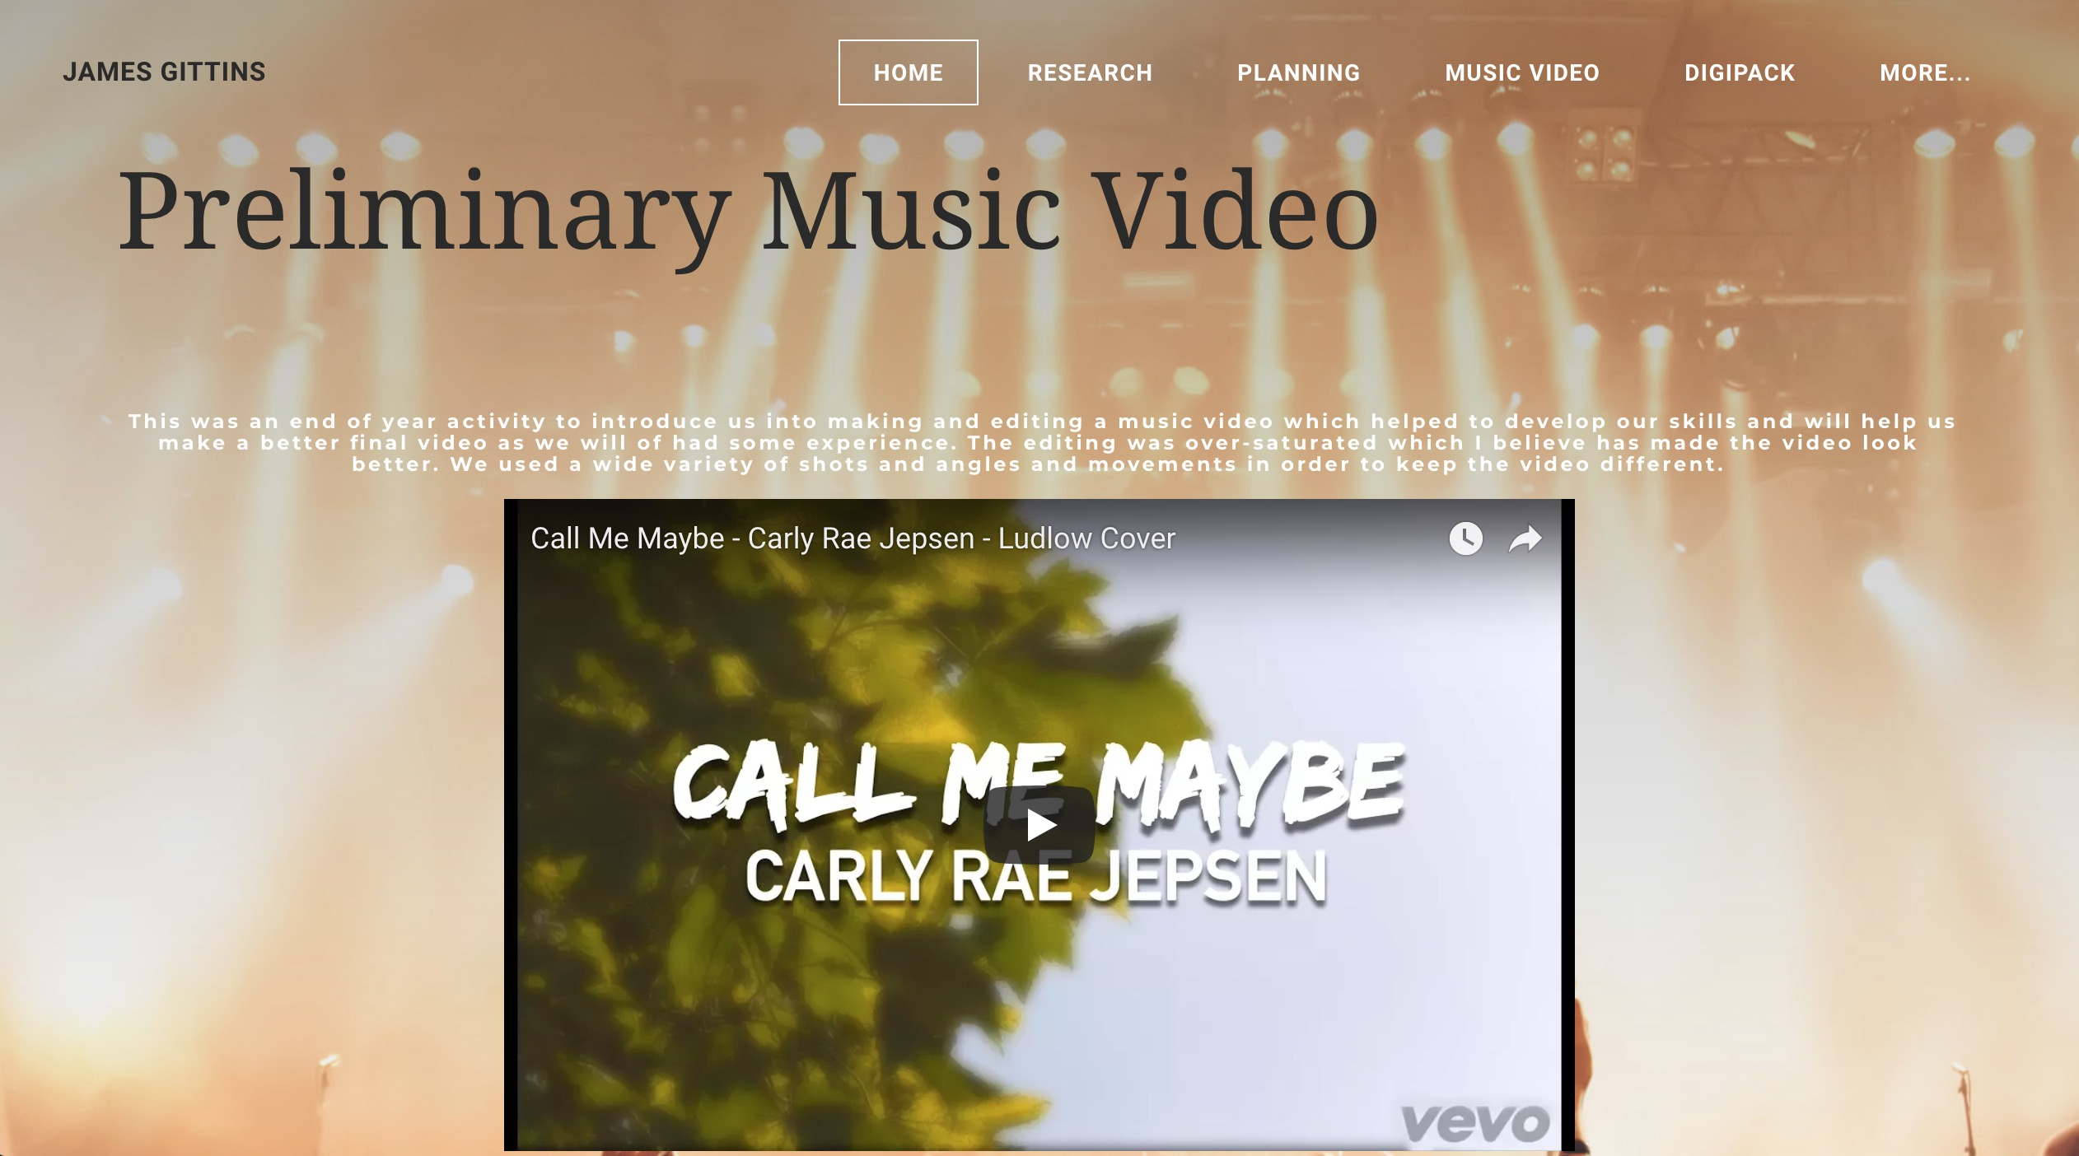
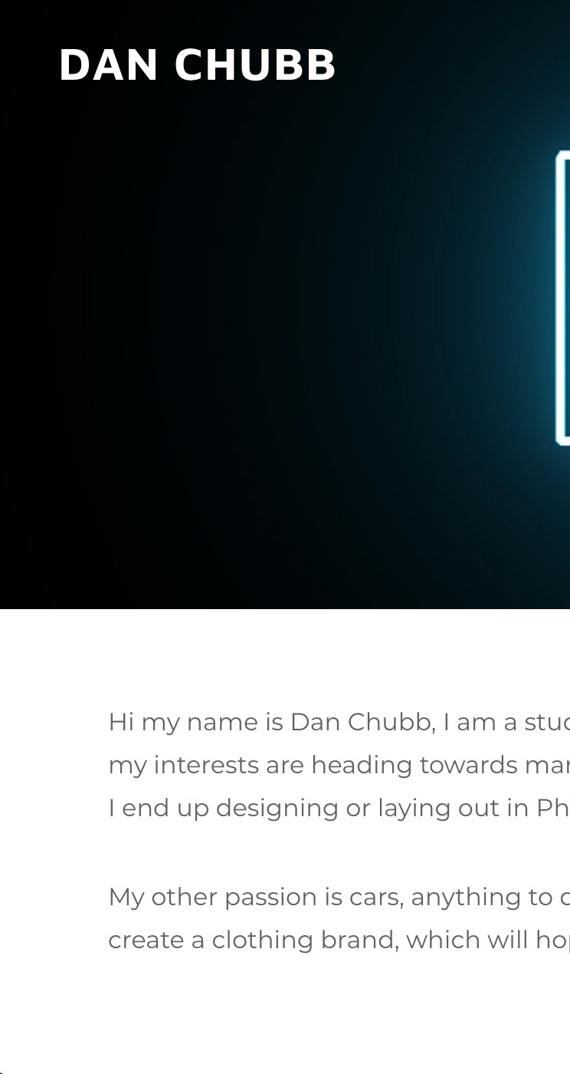
James's work Dan's Work Ben's Work
For our A2 Media Coursework, We had to do 2 ancillary tasks which were to create a Digipak and a print advert. There were 3 of us in the group and each one of us did 2-3 digipaks each and 2-3 print adverts each. The main focus was to link the products to the music video which makes the overall combination of products very effective and allows people to make a link between the products which should help sell the song ‘Afterglow’ to as many people as possible. We also needed to make sure the products linked to our target audience. By doing these ancillary tasks it allowed us to have some inspiration for our own digipak and print advert for our music video. It allowed us to see what type of design is suitable and ideal for our target audience and what others are designed like based on the genre.

Slide 3
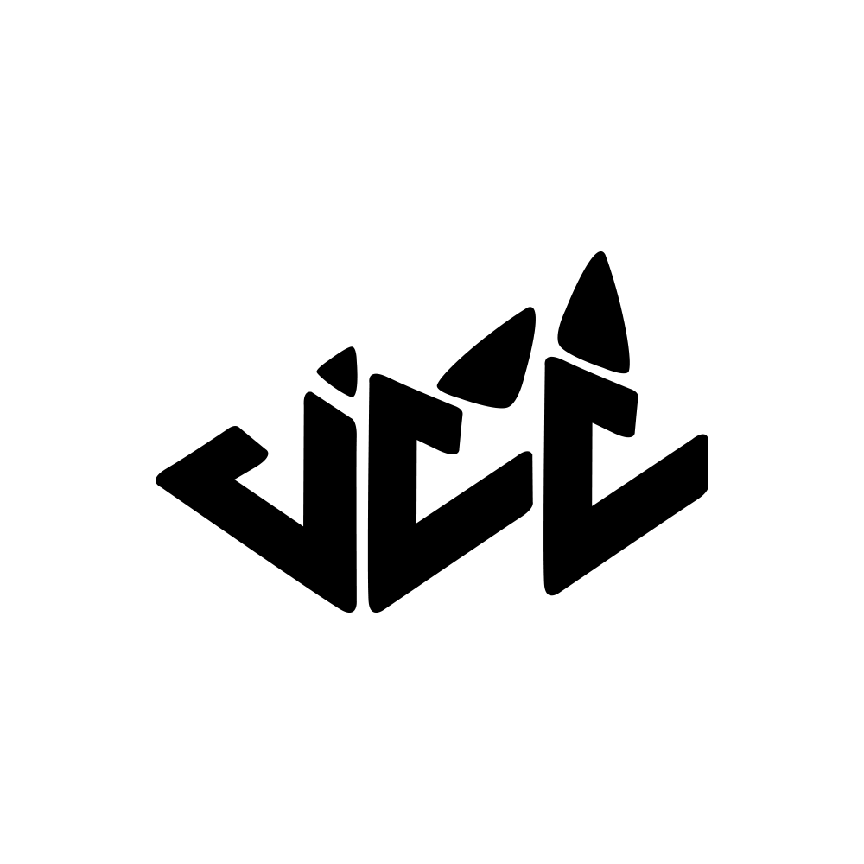
The functions of a print advert is to help promote and sell a music video. They will let you know about when a new song/ CD is being released. They do this by putting the main features on the advert which usually include an image of the artist or something that relates strongly to the artist such as there logo and the name of the new song/CD.
The functions of a Digipak would include brand identity, colours and logos. By using a Digipak a brand identity can be created so you can automatically link the Digipak to the artist and know who the artist is just by the name of the title or the logo displayed by the CD. The use of a Digipak helps promote the artist and their songs.
Digipak research (Ben’s)
Poster research (Ben’s)

Slide 4
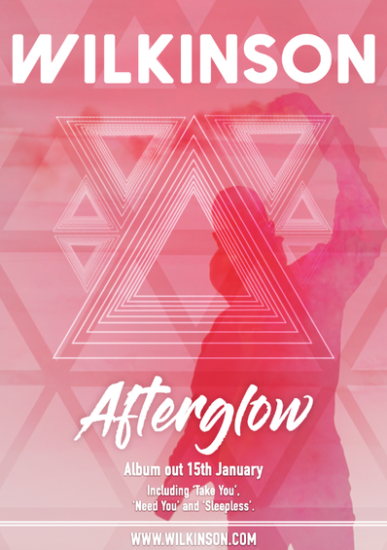
Our print advert achieves the functions of a print advert by using the general features that you usually see on a print advert for a music video, Such as the name of the artist ‘Wilkinson’ and title of the song ‘Afterglow’. It also includes the date the album is out which allows the audience to know when they will be able to buy the song from. It also has the names of the other tracks included in the CD. There is also the name of the website which helps promote the artist as it sends the audience to look at the website which will have more information about the artist such as the artists other songs and tour dates etc.
Click the picture above to learn more about how this print advert was created

Slide 5
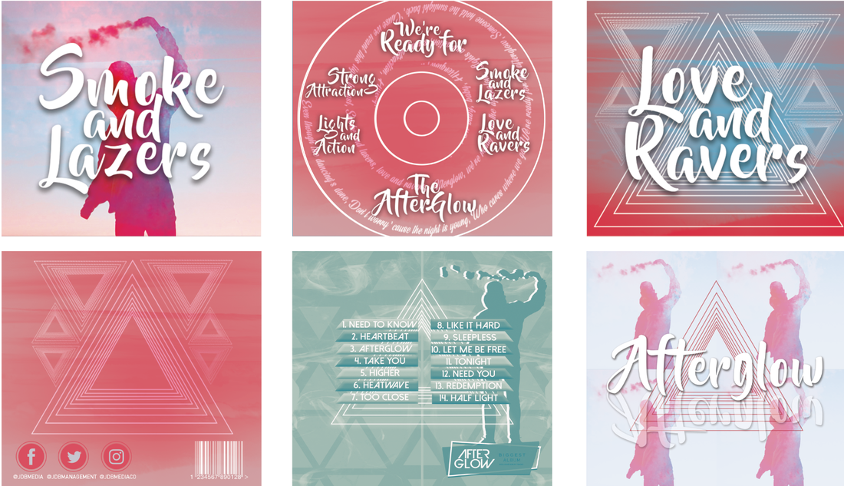
Our Digipak achieves the functions of a Digipak as it has a strong link with our other products which creates a strong brand identity. On the front cover the image of the figure with the smoke is very similar to what you see in our music video which allows the audience to create a link between the two of them. There is also lyrics from the song in our digipak such as ‘Smoke and Lasers’ and ‘Love and Ravers’ which have there own single panel each which creates a strong link to our music video. The colours used are also very similar to the colours you see in our music video which again creates a strong link between the products. There is also the promotion of the artists social media links such as Facebook, Twitter and Instagram which helps the artist grow.
Click the picture above to learn more about how this digipak was created

Slide 6
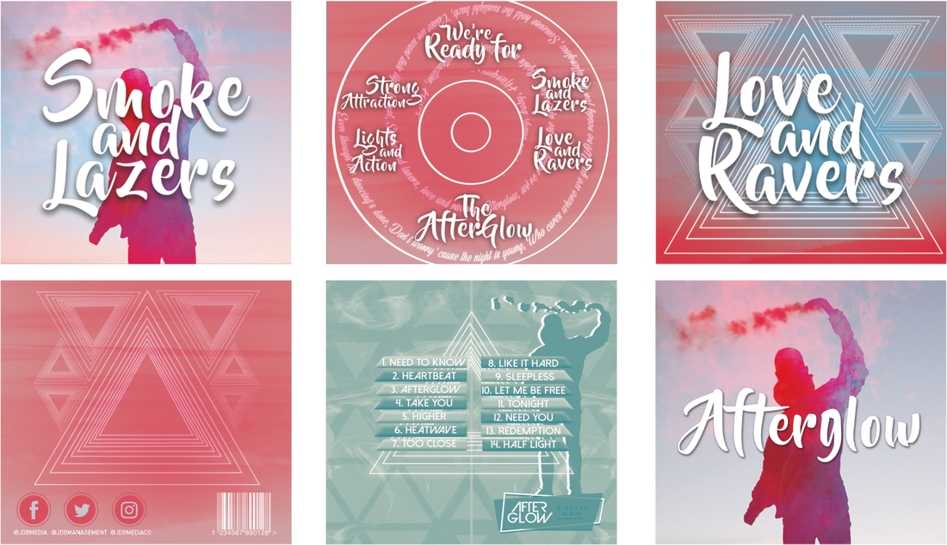
Font of ‘Afterglow’ is the same throughout each product – it allows the audience to create a link between each product and so therefore helps with the promotion of the song, products and the artist.
Very similar colours used in the print advert and digipak, These colours used are bright – This again creates a link for the audience between the products and so therefore helps again with promotion.
Overall, seamless links between each professional quality product, which makes the overall combination very effective at its purpose, to sell the song Afterglow to as many people as possible.

